Slide 1
CS 341 Lab introduction
Fall 2020

Slide 2
Contact Info + websites
Email me for grades or if you would like to setup a 1:1 meeting (jack.davis001@umb.edu)
Office Hours: by appointment only (send an email and I will setup a zoom meeting)
I will use piazza to post any class updates
Zoom links are posted on piazza
My slides, starter codes, and instructions are available here: github.com/jack17davis/cs341

Slide 3
Policies
Work in groups of 1 or 2
Post lab questions on Piazza with lab tag (privately if you need to share code)
makeup labs are allowed (due by 11:59PM on December 11th18th extended 1 week)
You may attend a different lab section if you need to
When using tinkercad, you should not use block code

Slide 4
Weekly Meetings
Starter code is available on GitHub: https://github.com/jack17davis/cs341
Step-by-step instructions will be posted on https://www.cs.umb.edu/~cheungr/cs341/
Lab introduction
Working lab demonstration
Q&A
Breakout rooms for real-time labs
Use the “help” button (under more) to get my attention
You are welcome to take longer or leave early
Lab report is due by the start of the next lab (typically a week)

Slide 5
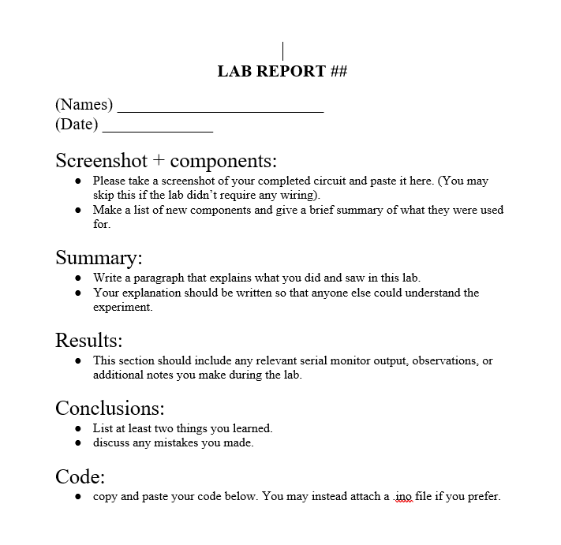
Lab Report Template
Labs can be written and submitted as a team
Submit by email to jack.davis001@umb.edu before your sections next meeting
There will be 10 labs
I’ll be grading each lab out of 10:
3 points for submitting the lab report on time
4 points for quality of lab report
3 points for code that works correctly
labs make up 20% of your final grade
If you can’t get your code working in time, please document what you tried and submit the lab anyway

Slide 6
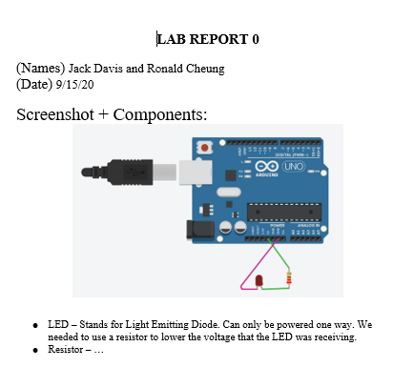
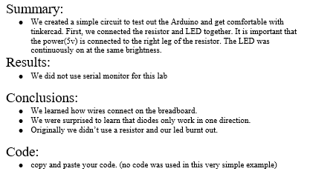
Example Lab Report

Slide 7
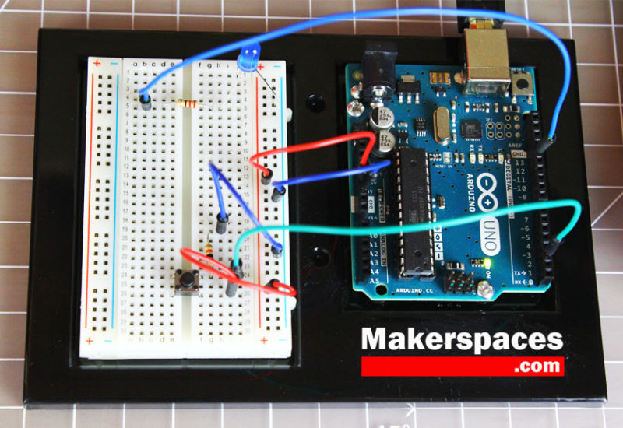
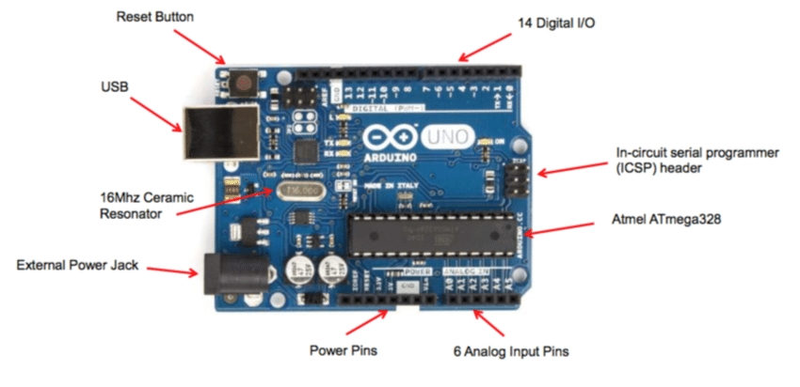
Arduino

Slide 8
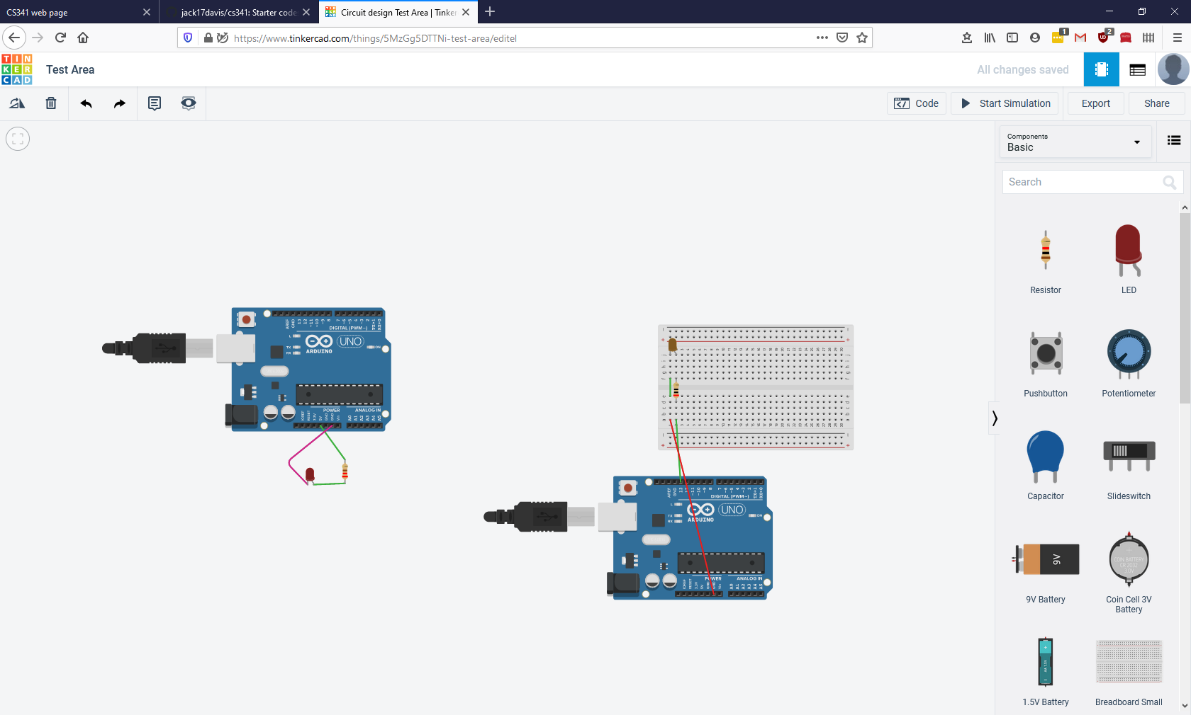
Tinkercad

Slide 9
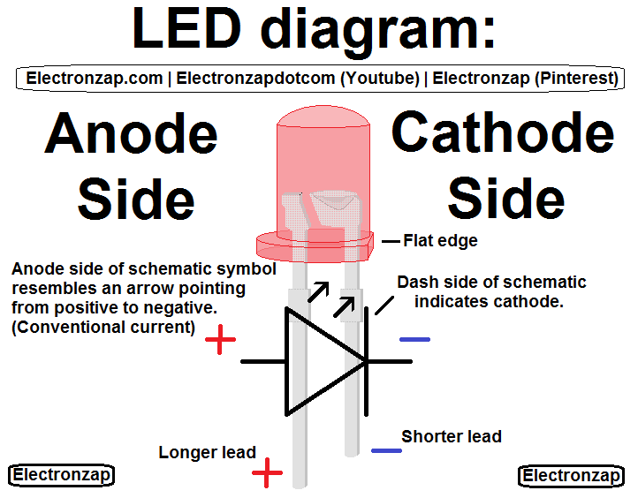
Background Information - LED
Light-emitting Diode (LED)
Power must flow anode (longer lead, round) to cathode or positive to negative
a change in the amount of electricity flowing results in a change in brightness

Slide 10
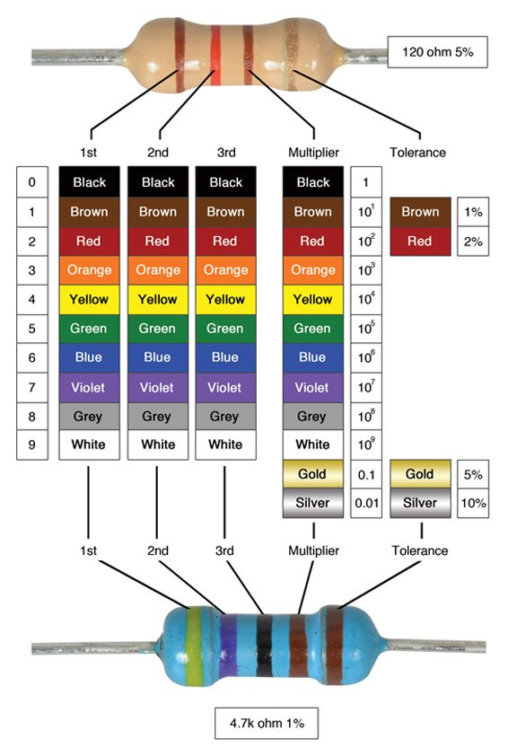
Background Information - Resistors
Resistor
reduces the amount of electricity flowing
Resistance is measured in ohms(Ω)

Slide 11
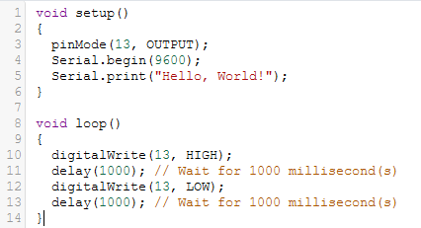
Background Information - Arduino
Syntax is almost identical to C/C++
setup() and loop() must always be present for Arduino code to compile
setup() runs once, loop run repeatedly
Serial.begin(9600) initializes the Serial monitor (a text window that we can print to)
delay(int x) waits x milliseconds
To use a pin:
First initialize it as either INPUT or OUTPUT using pinMode()
digitalWrite(int pinNumber, HIGH or LOW)
More options will come in future labs

